Slide 1
REVIEW-3 Online Employee Tracking System
Presented by:
2010030463_M.Anil kumar
2010030490_K.Varun krishna
2010030526_D.Dedeepya
2010030530_K.Sriteja
Presented by:
2010030463_M.Anil kumar
2010030490_K.Varun krishna
2010030526_D.Dedeepya
2010030530_K.Sriteja
Guided by:
Madhukar Rao sir
Sasidhar sir

Slide 2
Table of Contents
Documentation (Code Explanation)
Github commits
Work progress
Beta testing

Slide 3
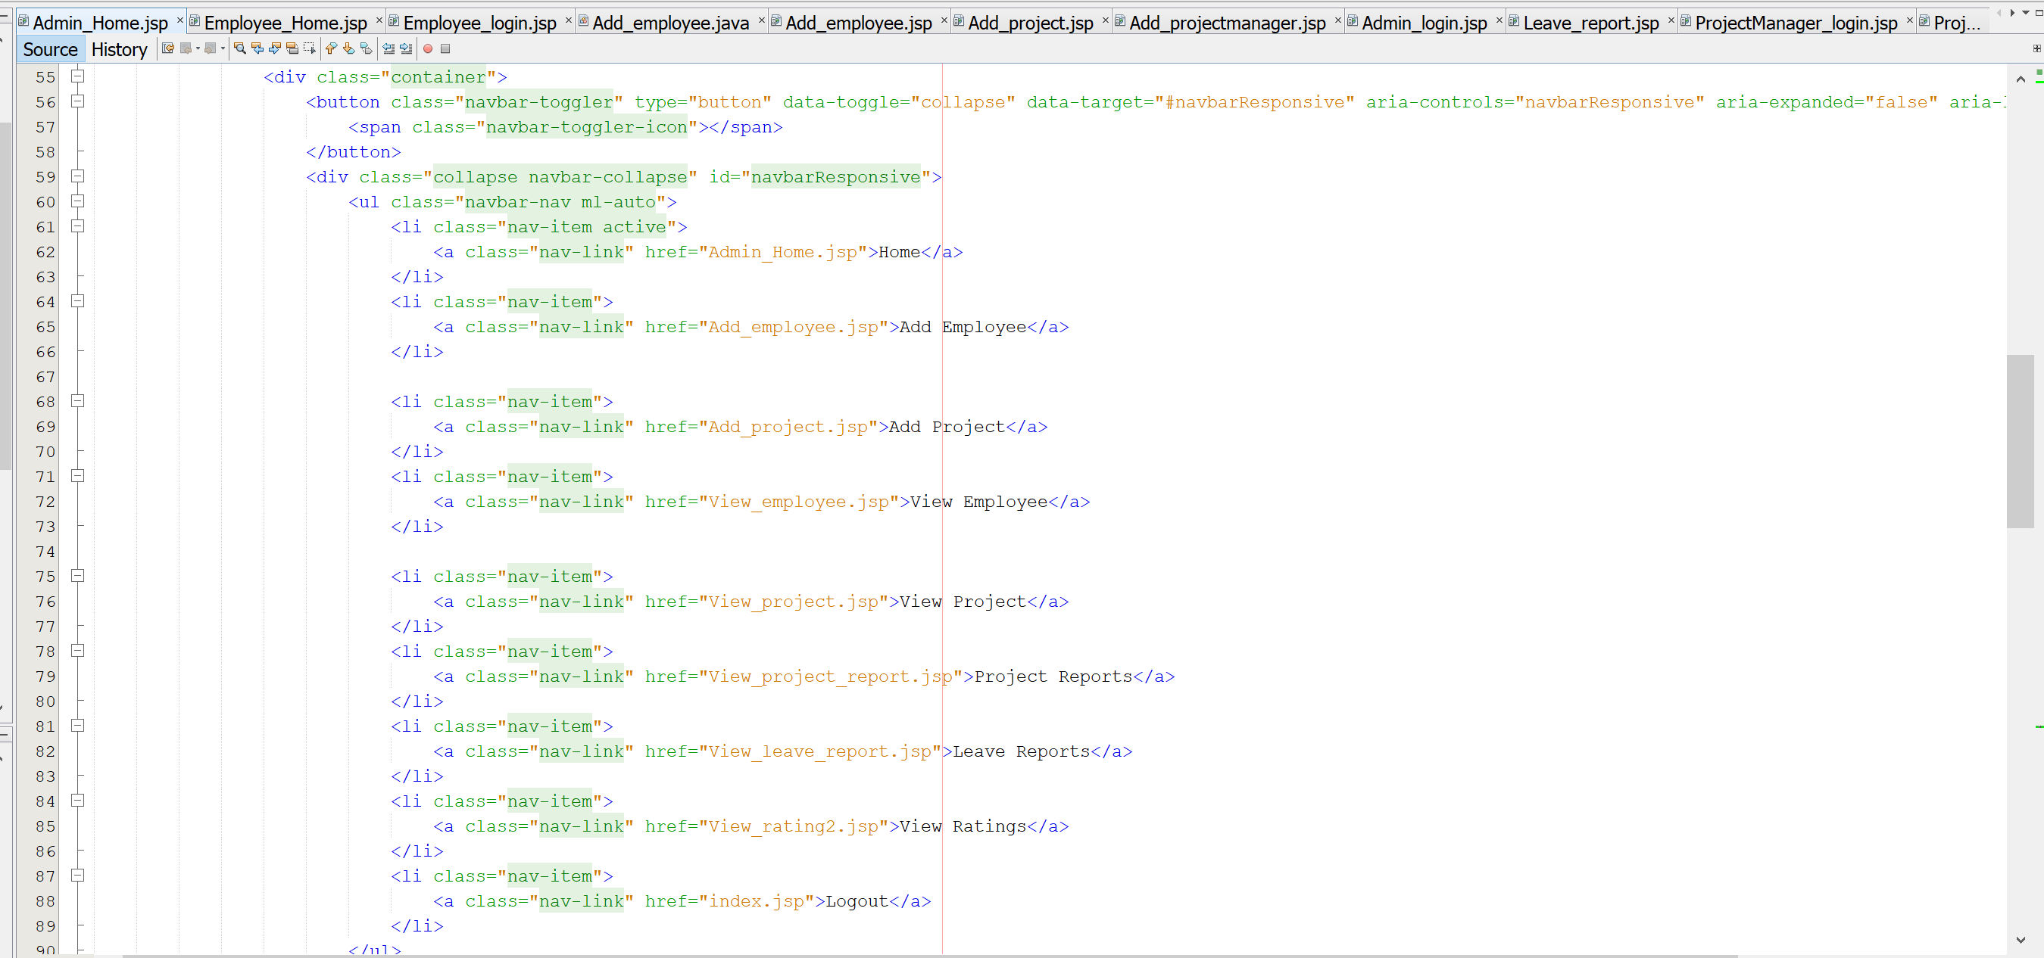
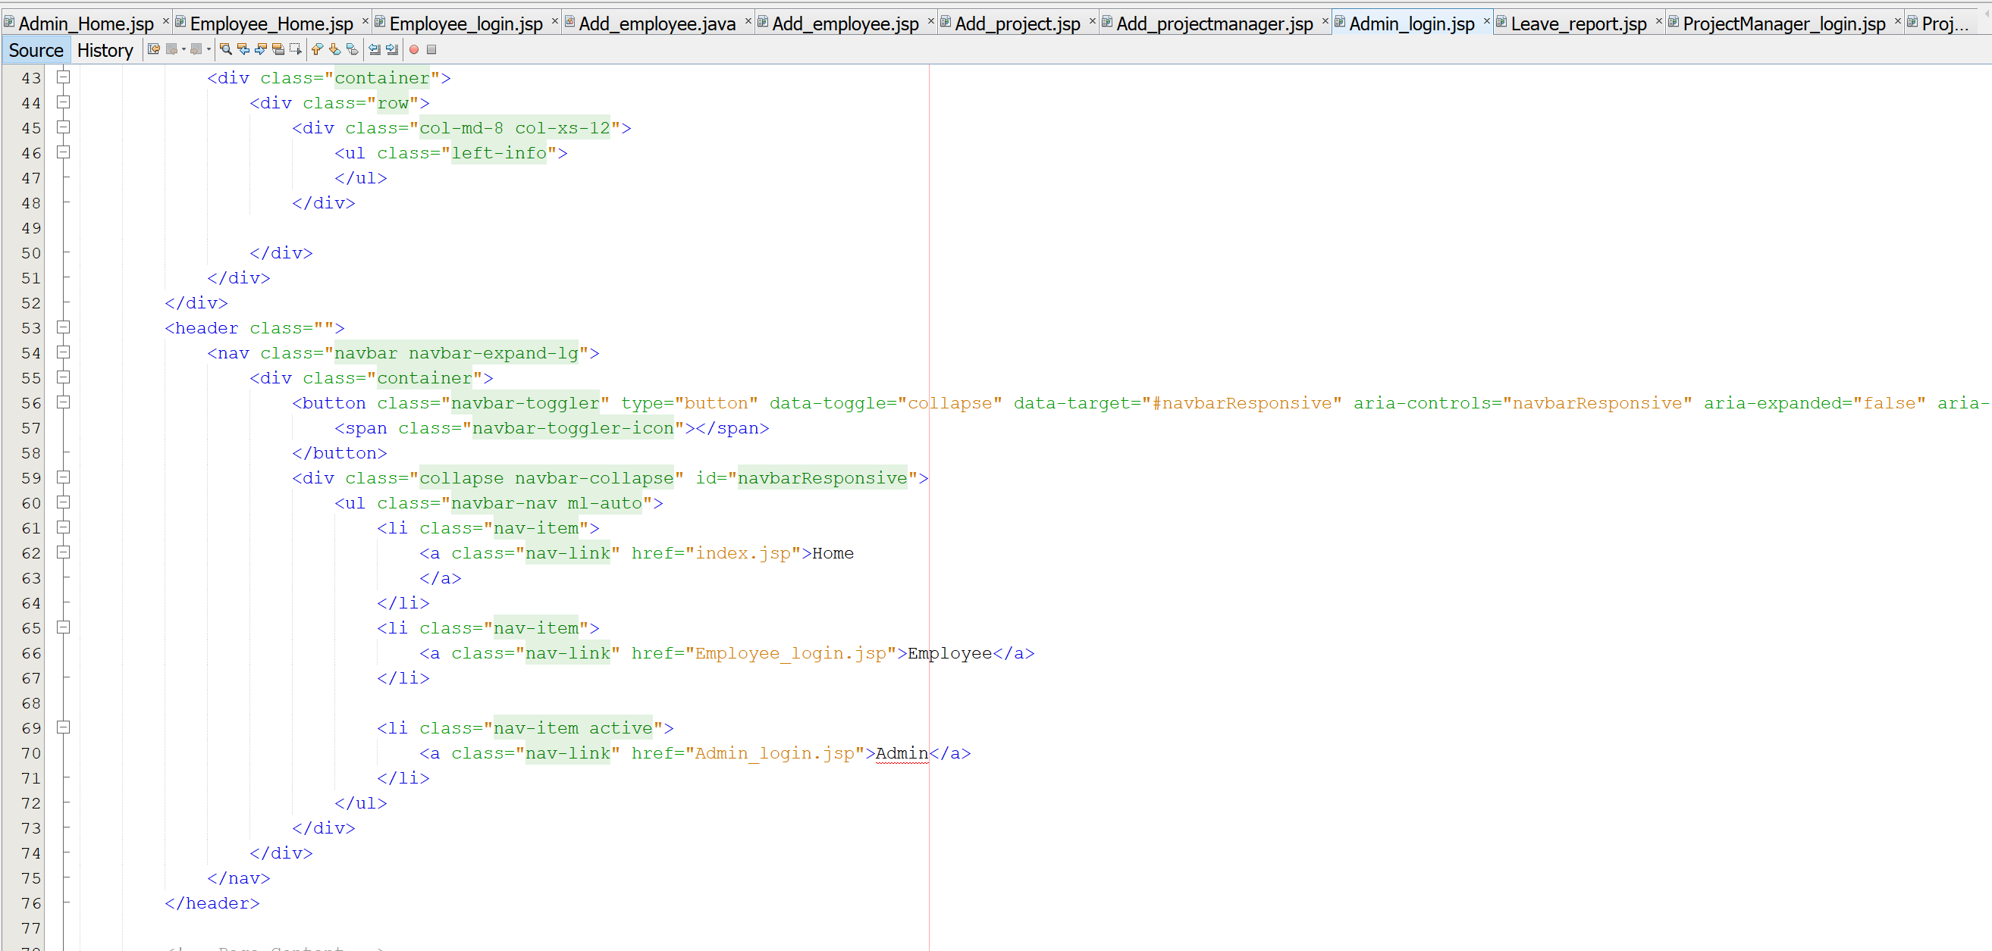
Documentation (Code Explanation)

Slide 4
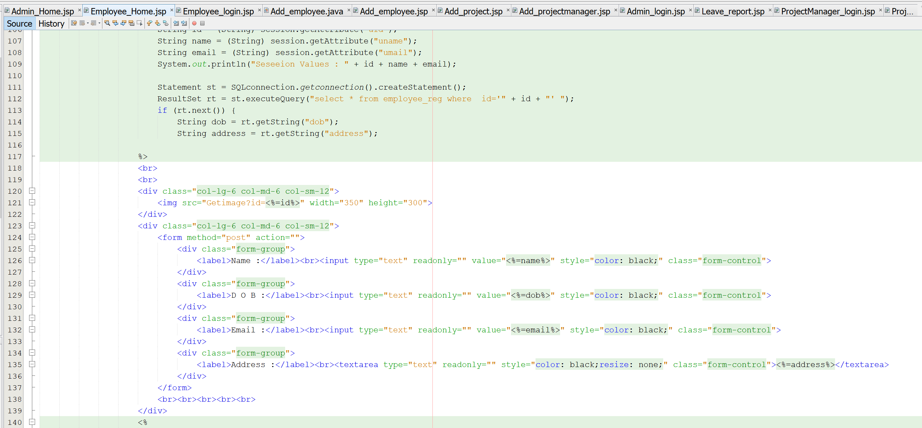
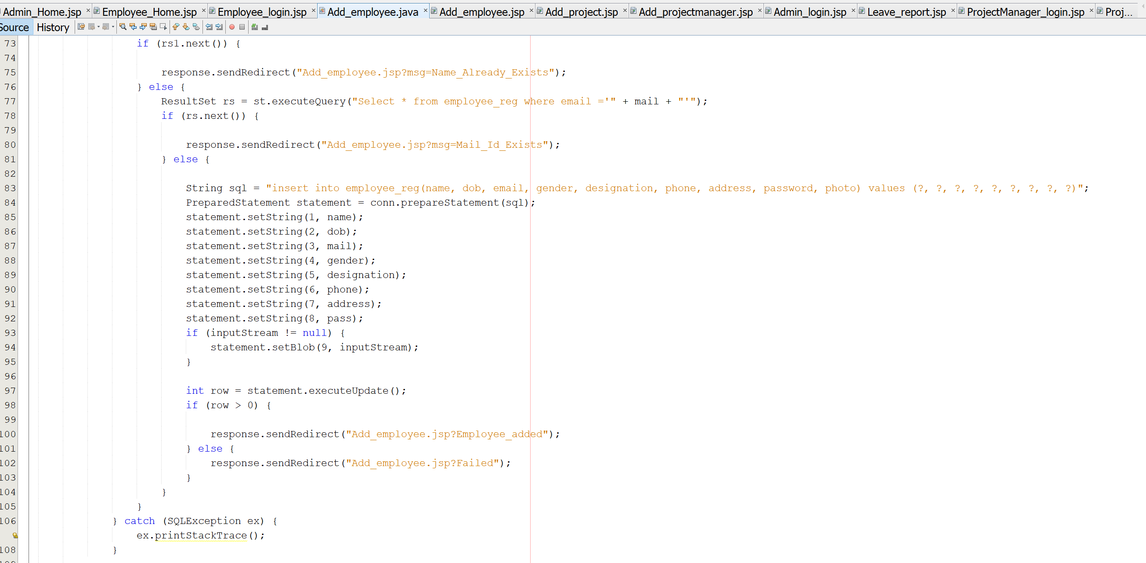

Slide 5
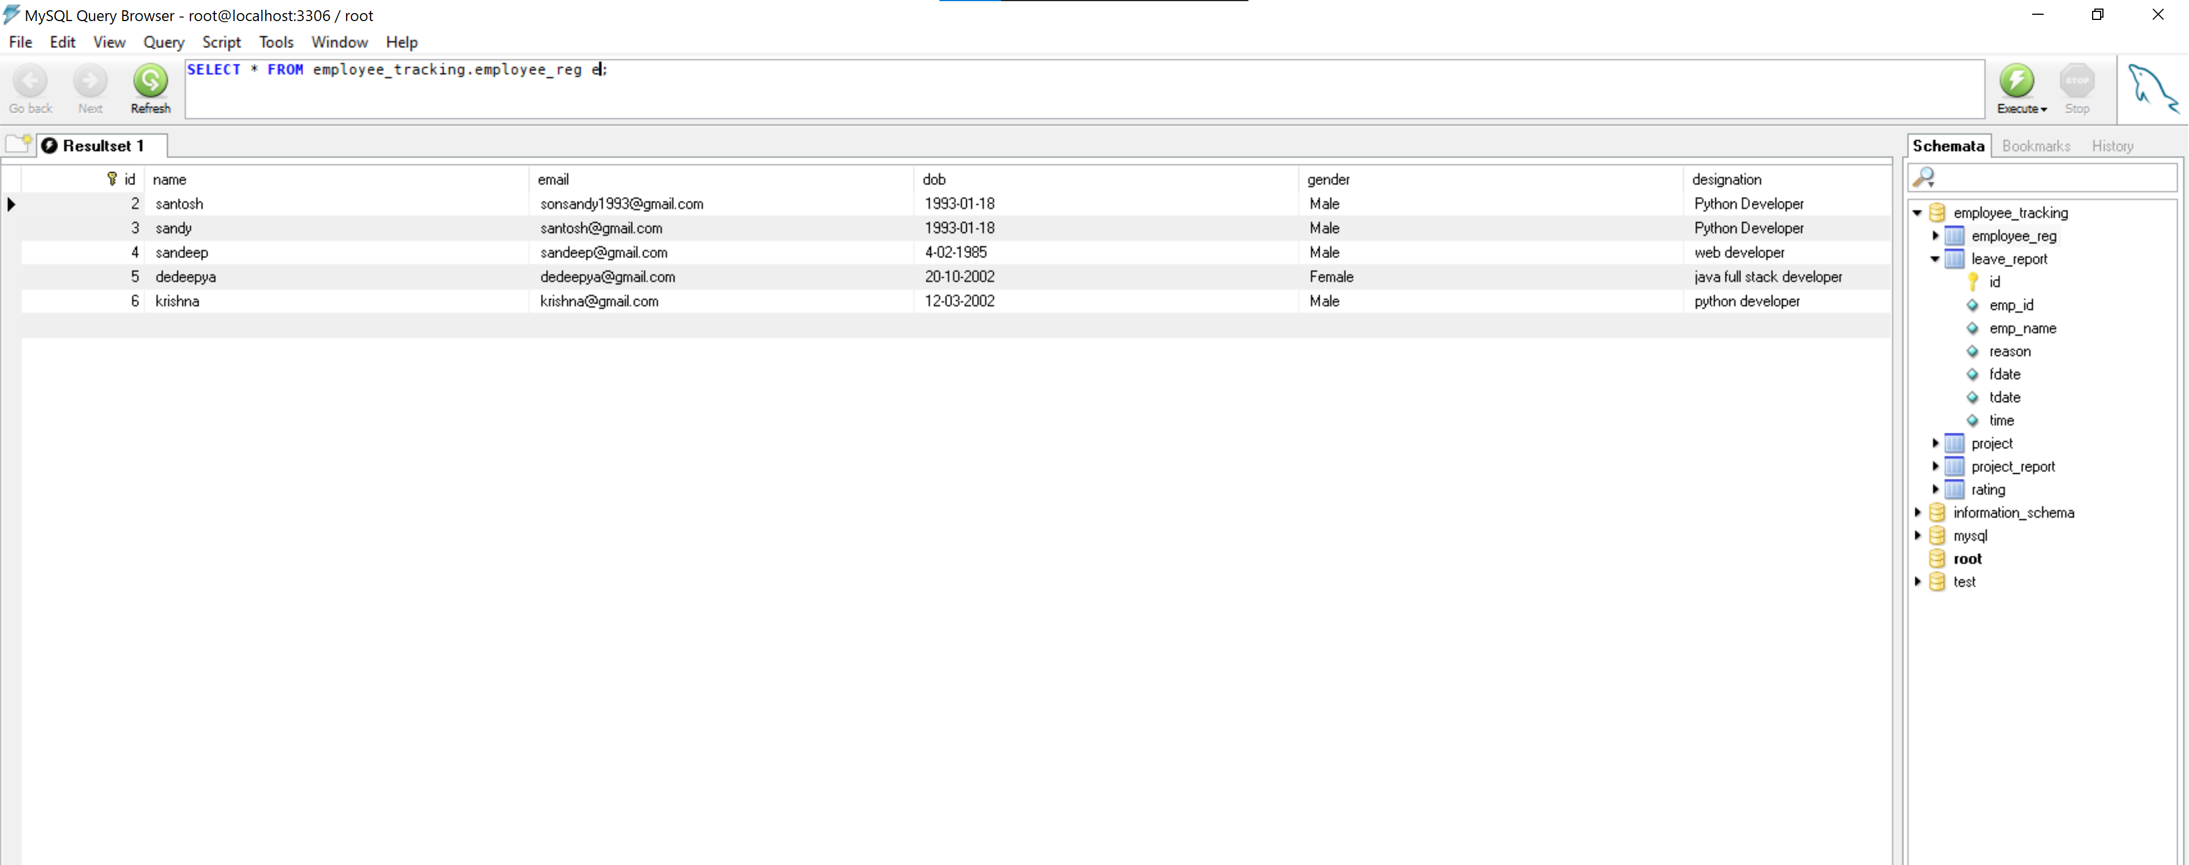
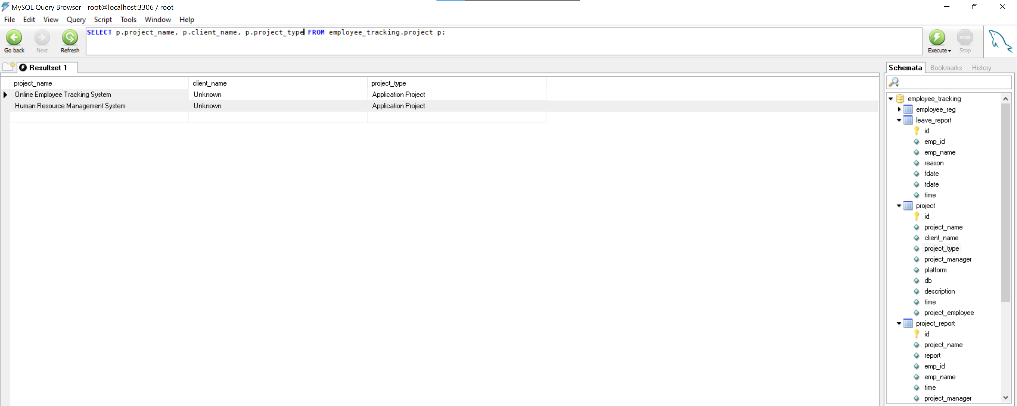

Slide 6
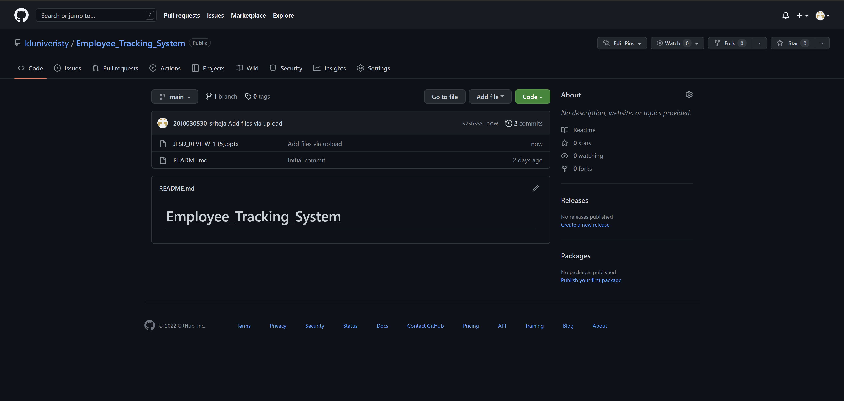
Github setup
Link : https://github.com/kluniveristy/Employee_Tracking_System

Slide 7
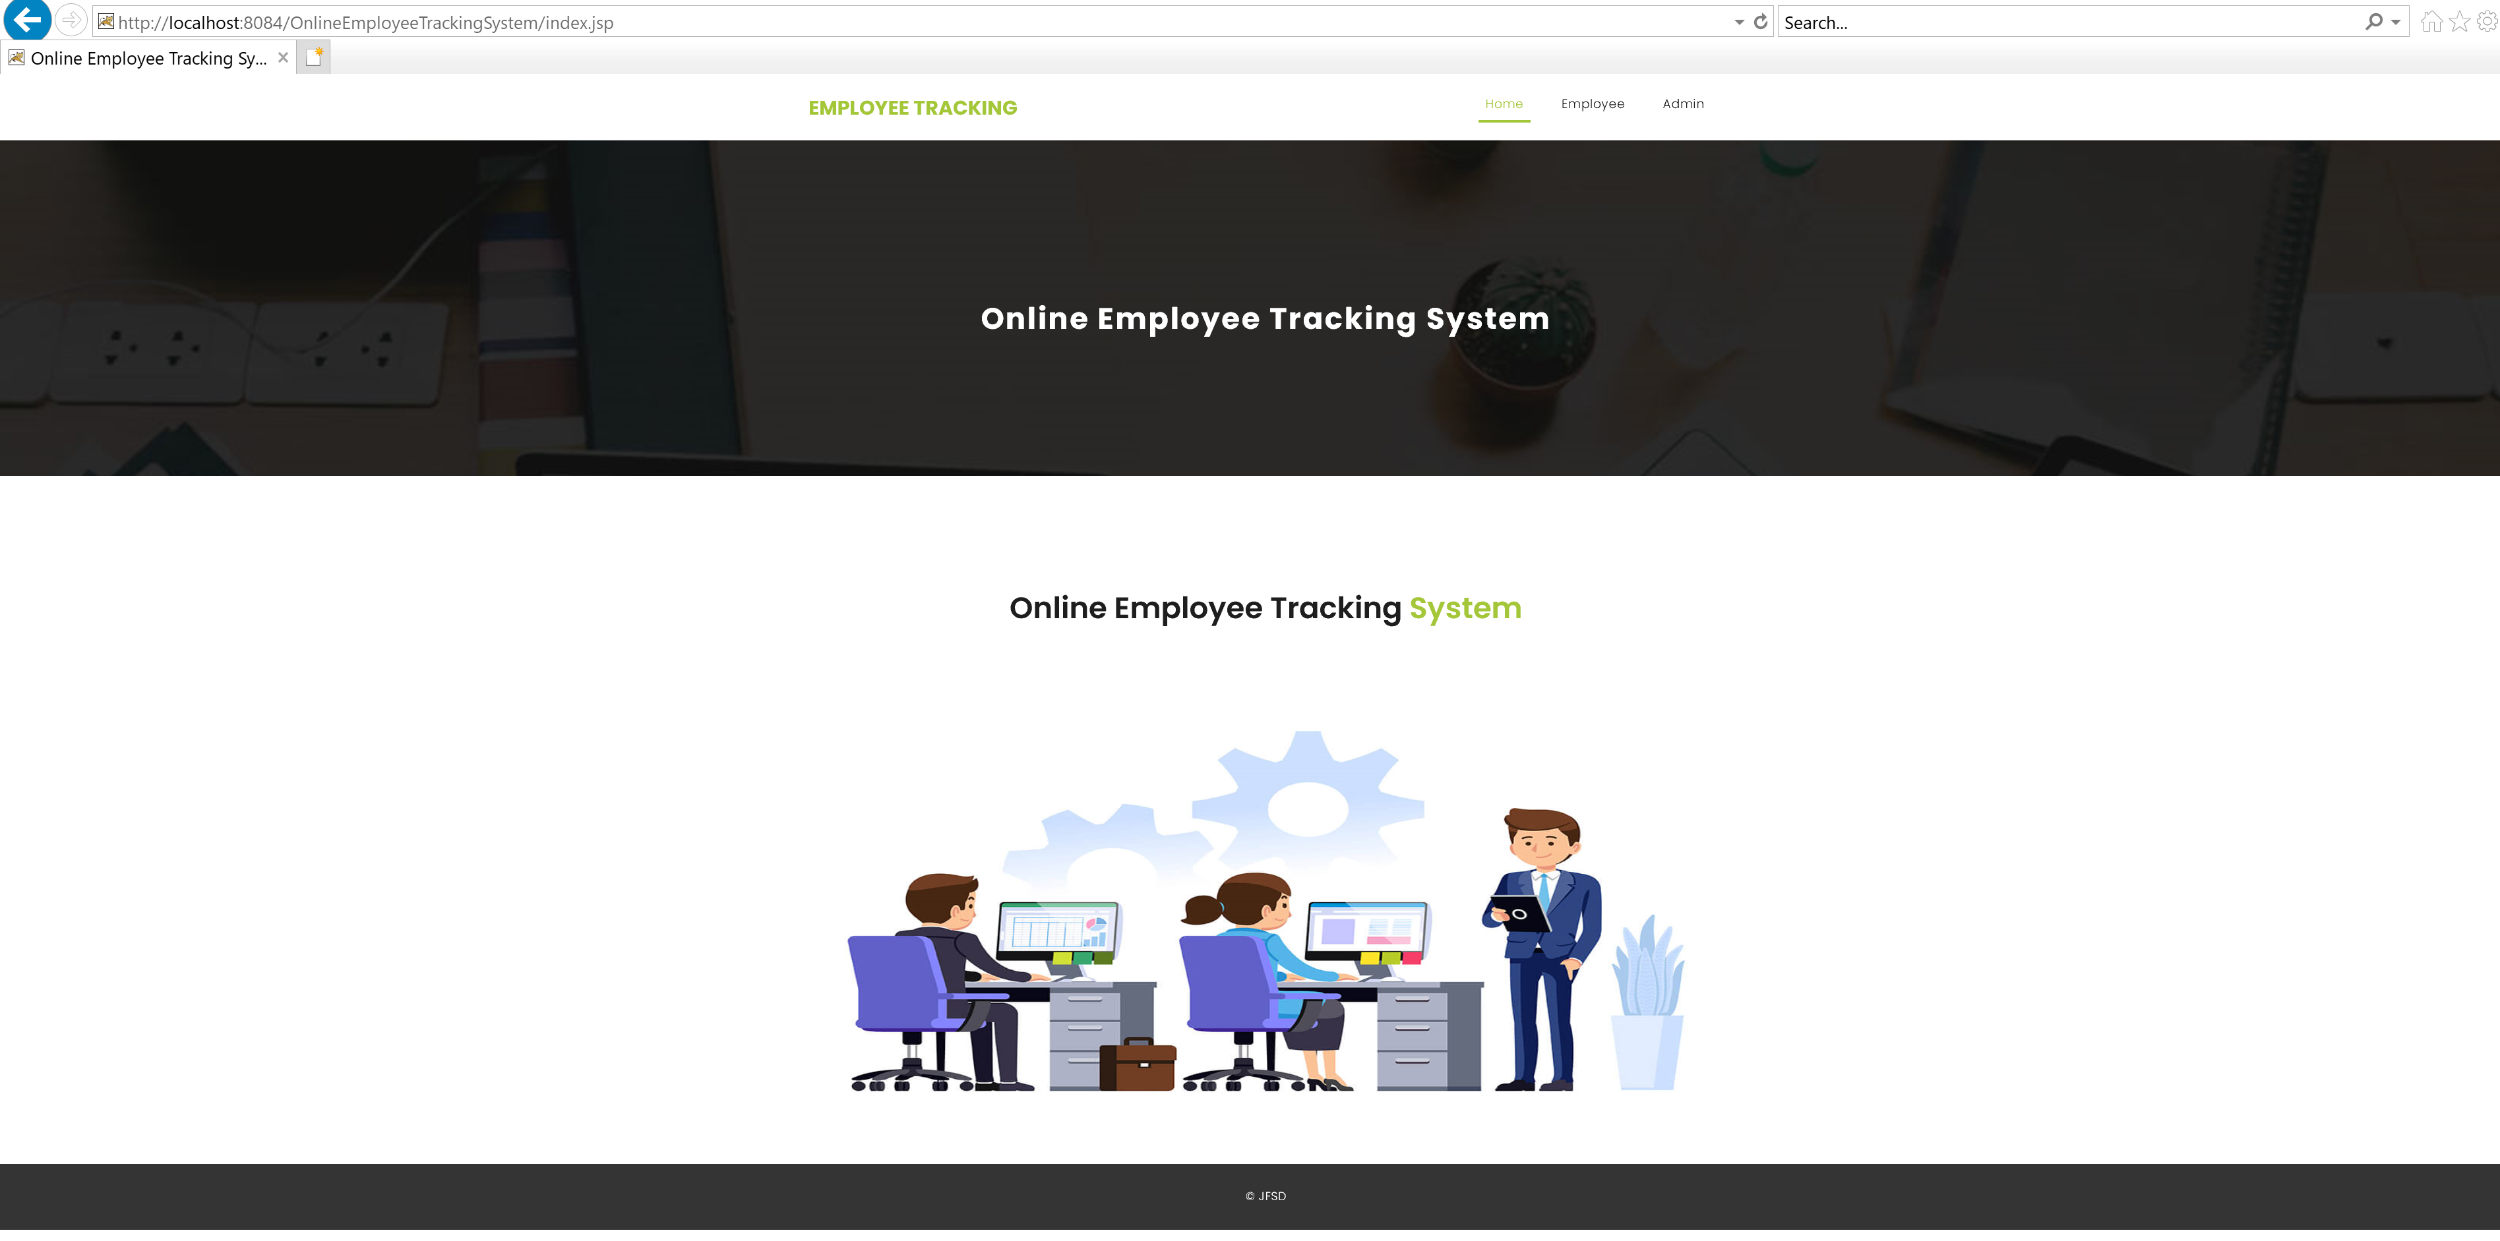
Work progress
Created 2 modules named employee and admin.
Created required jsp files. And also established connection with MYSQL Query.

Slide 8
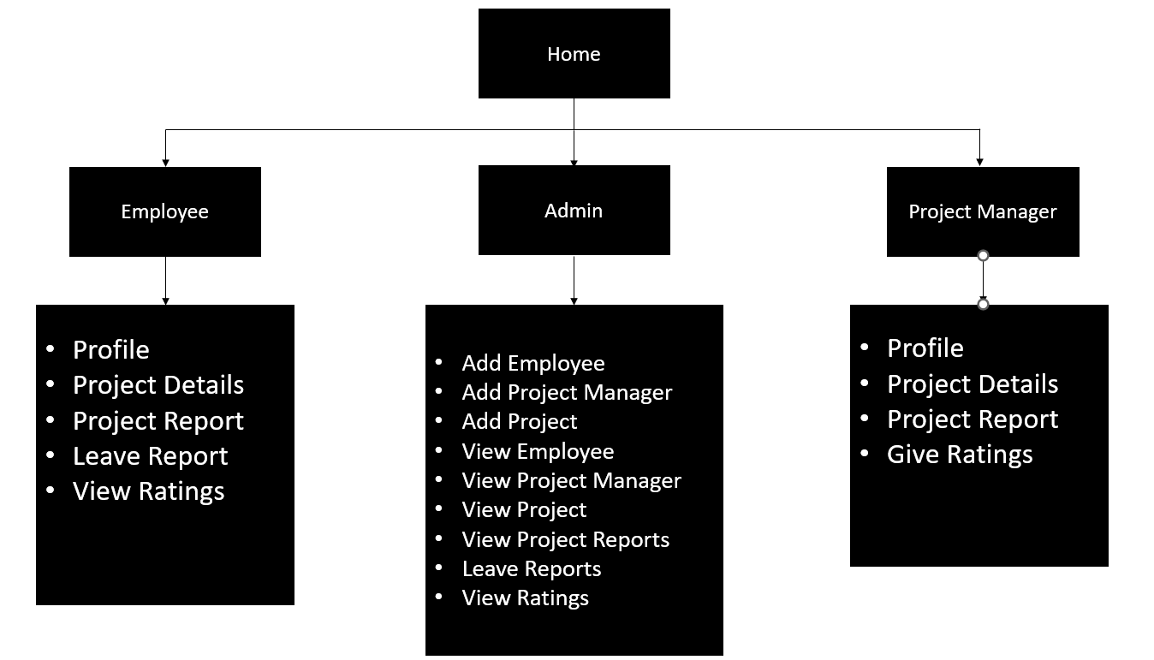
Overview

Slide 9
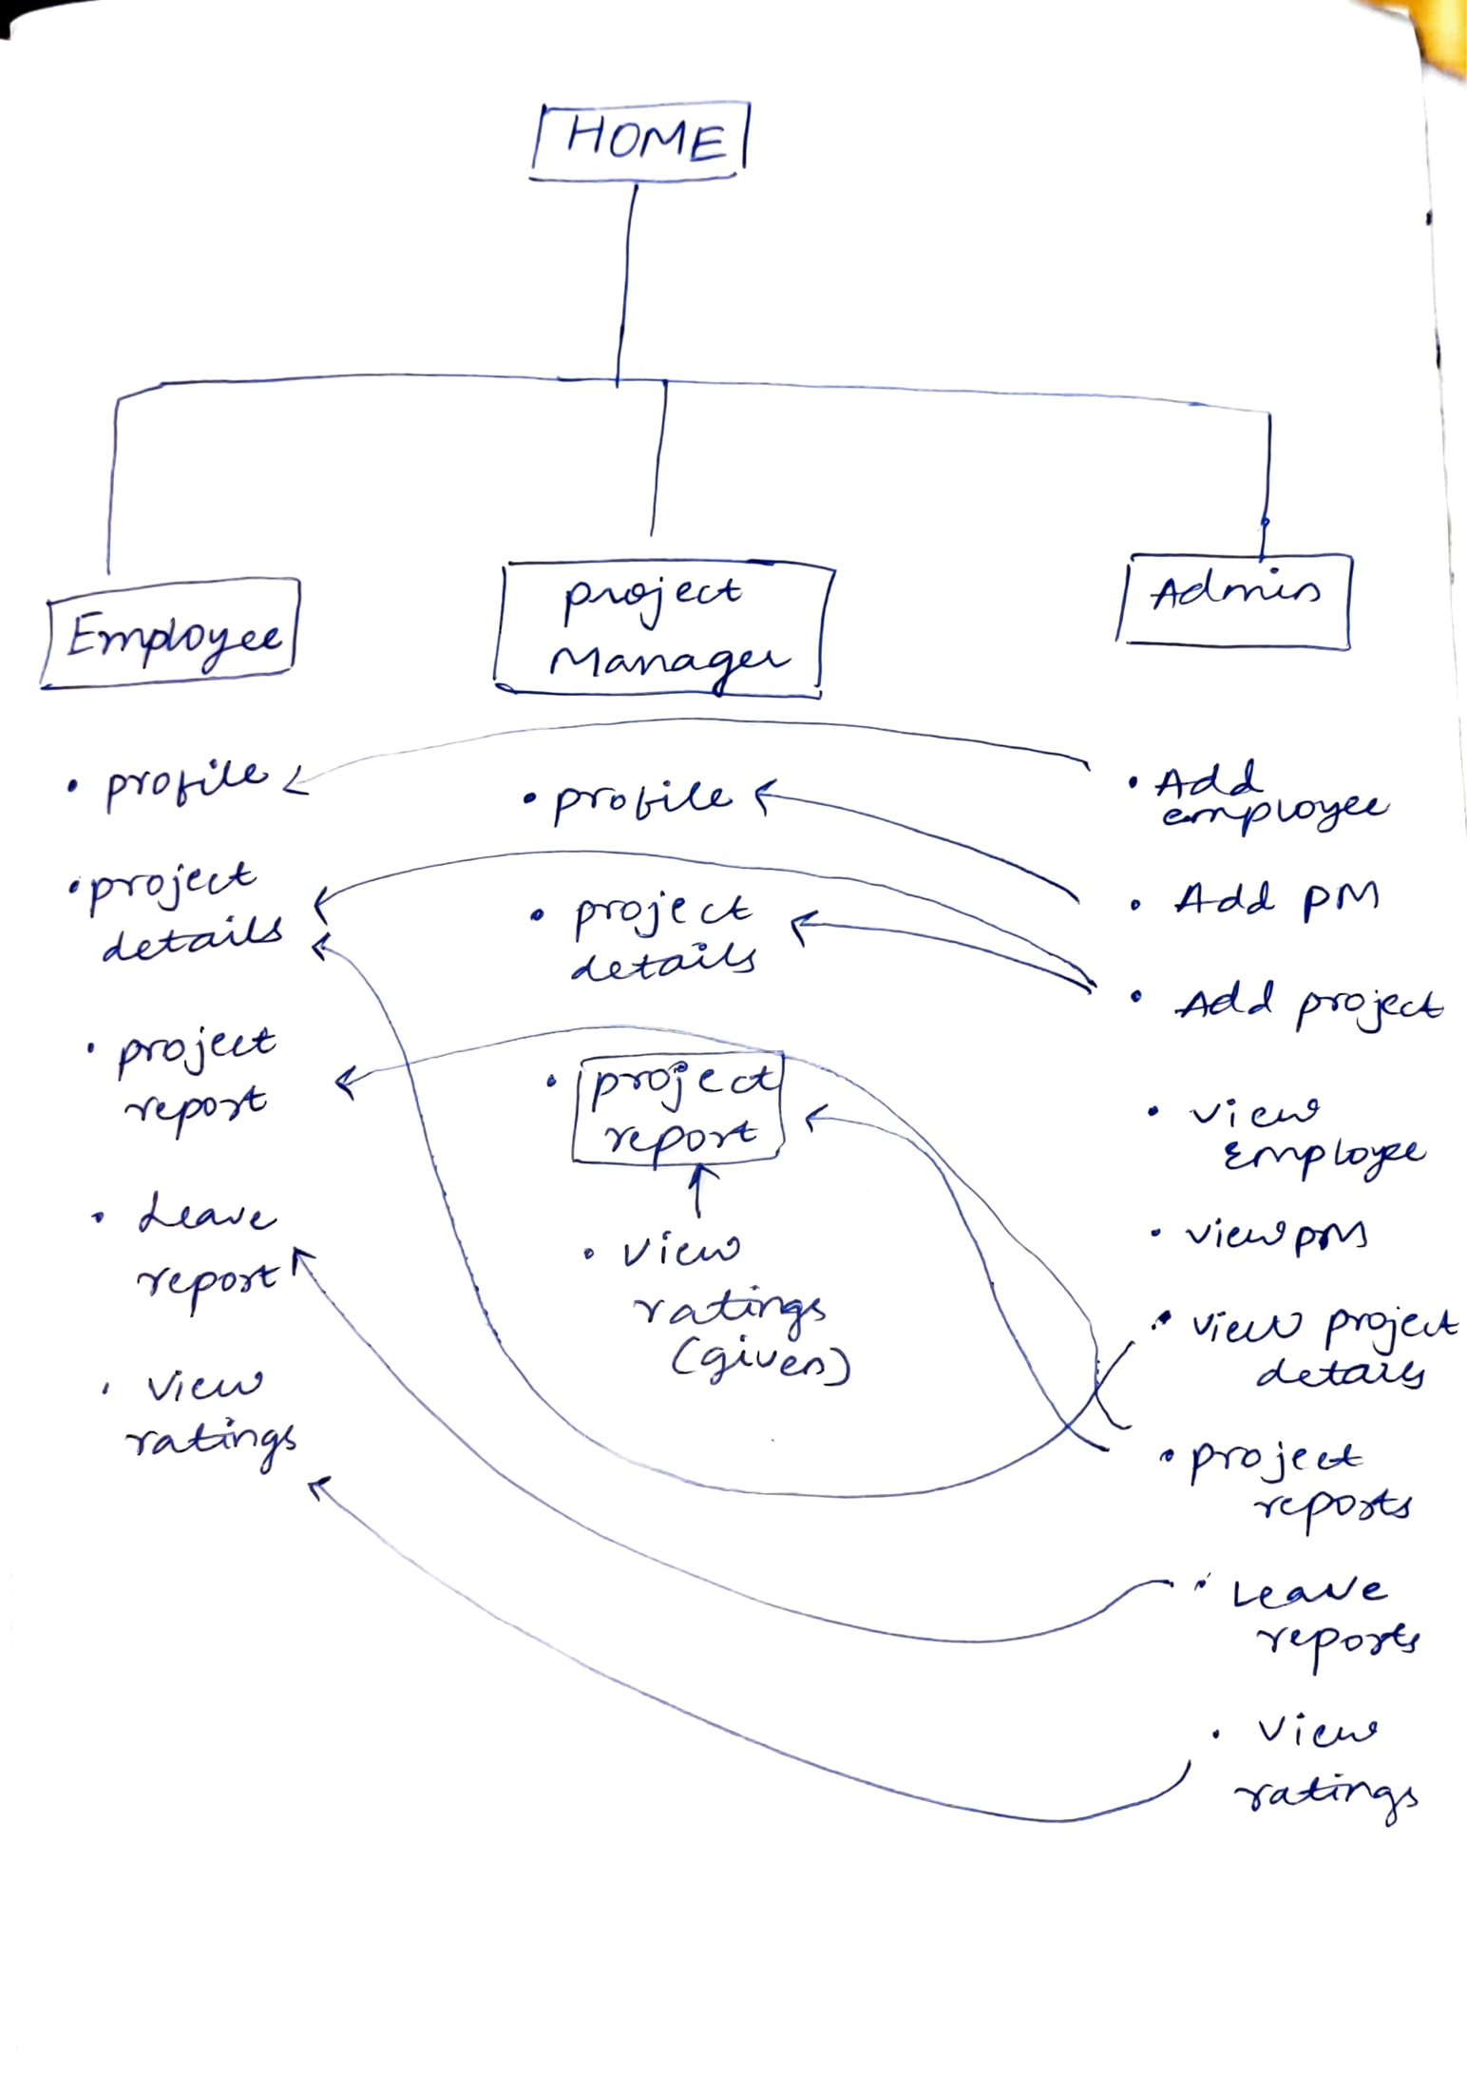

Slide 10
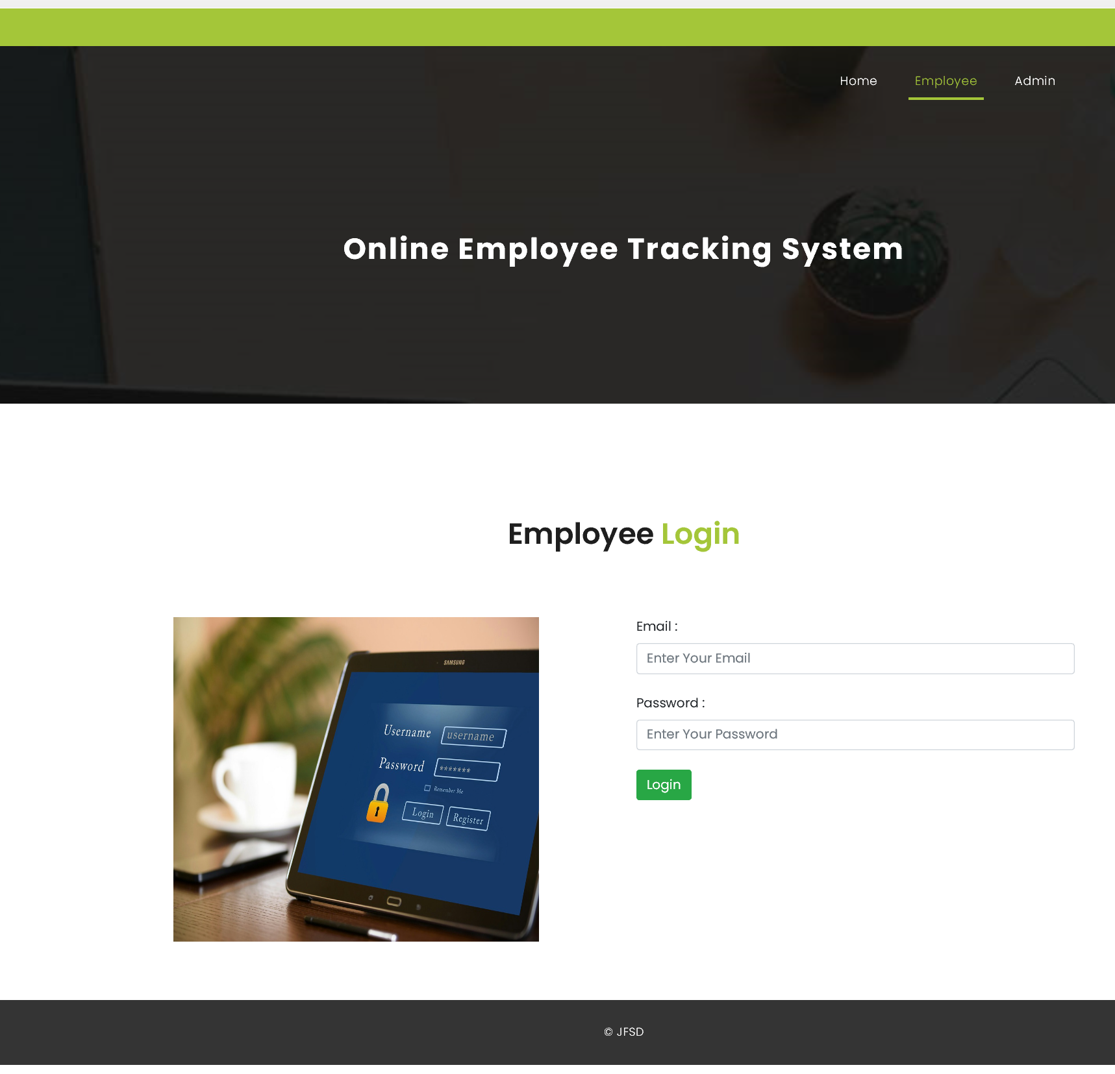
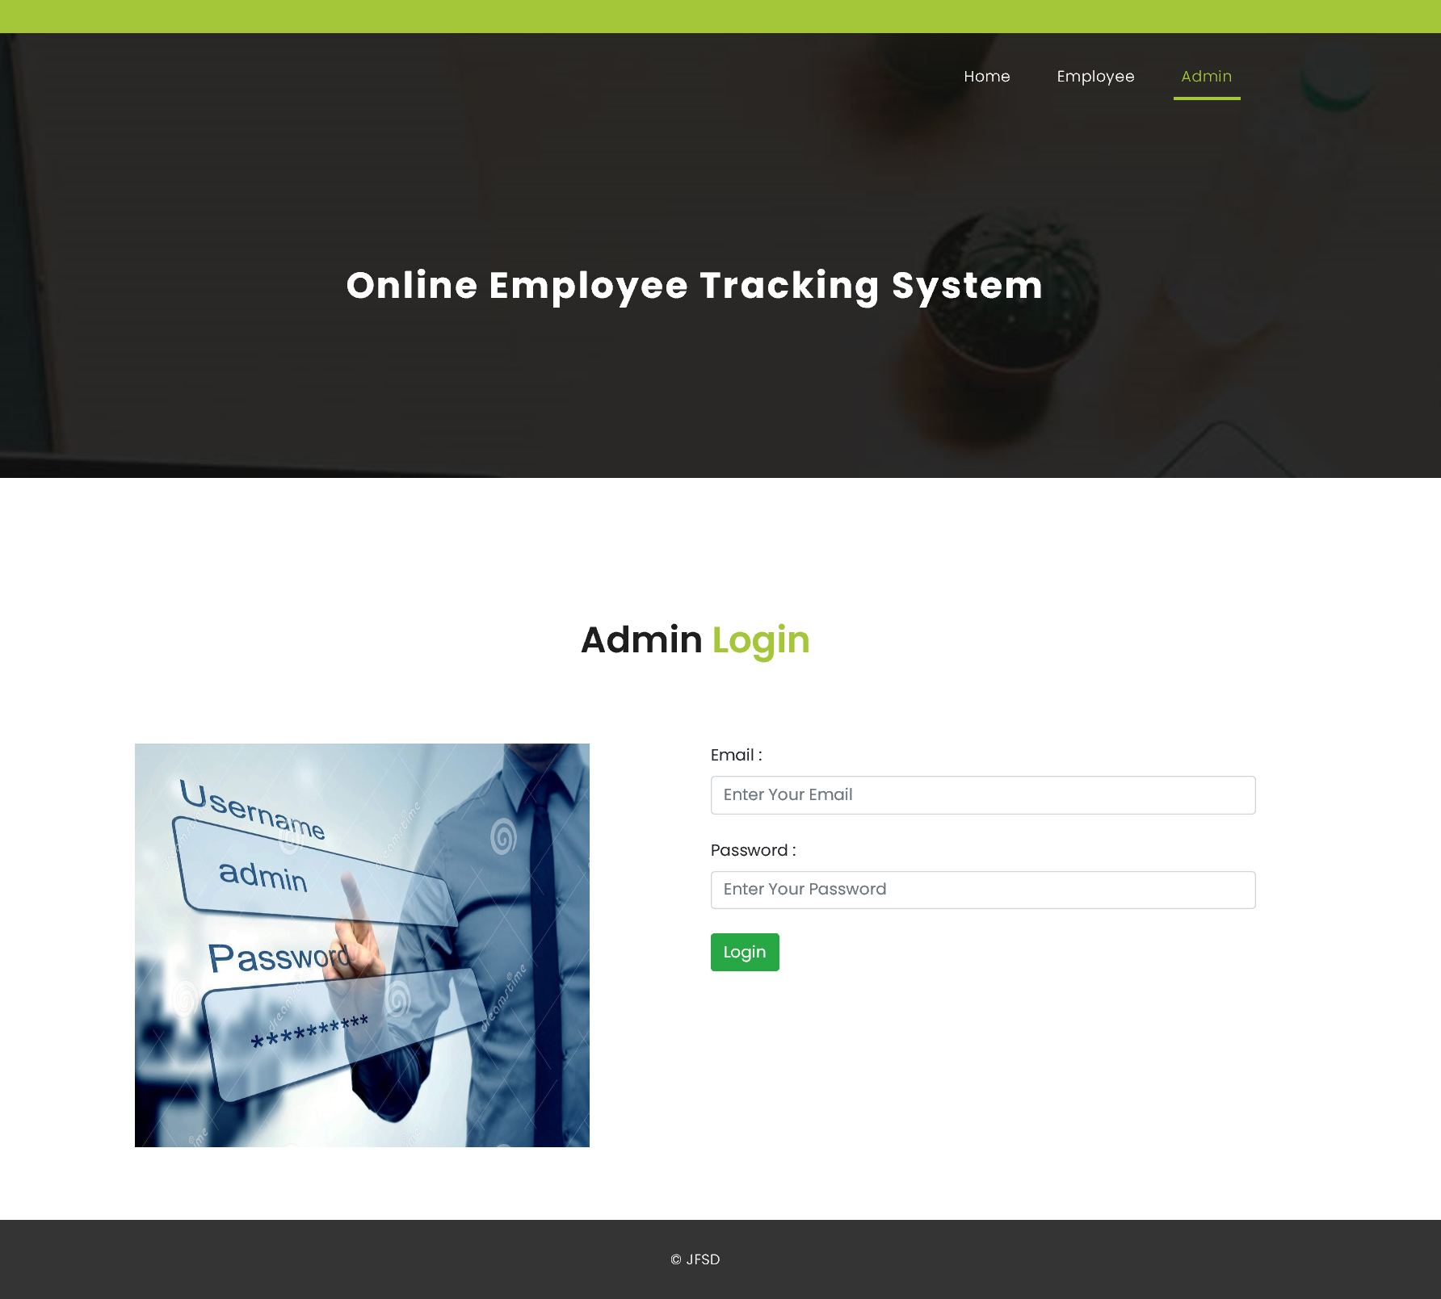
Beta Testing:
All field entries must work properly.
Pages must be activated from the identified link.
The entry screen, messages and responses must not be delayed.

Slide 11
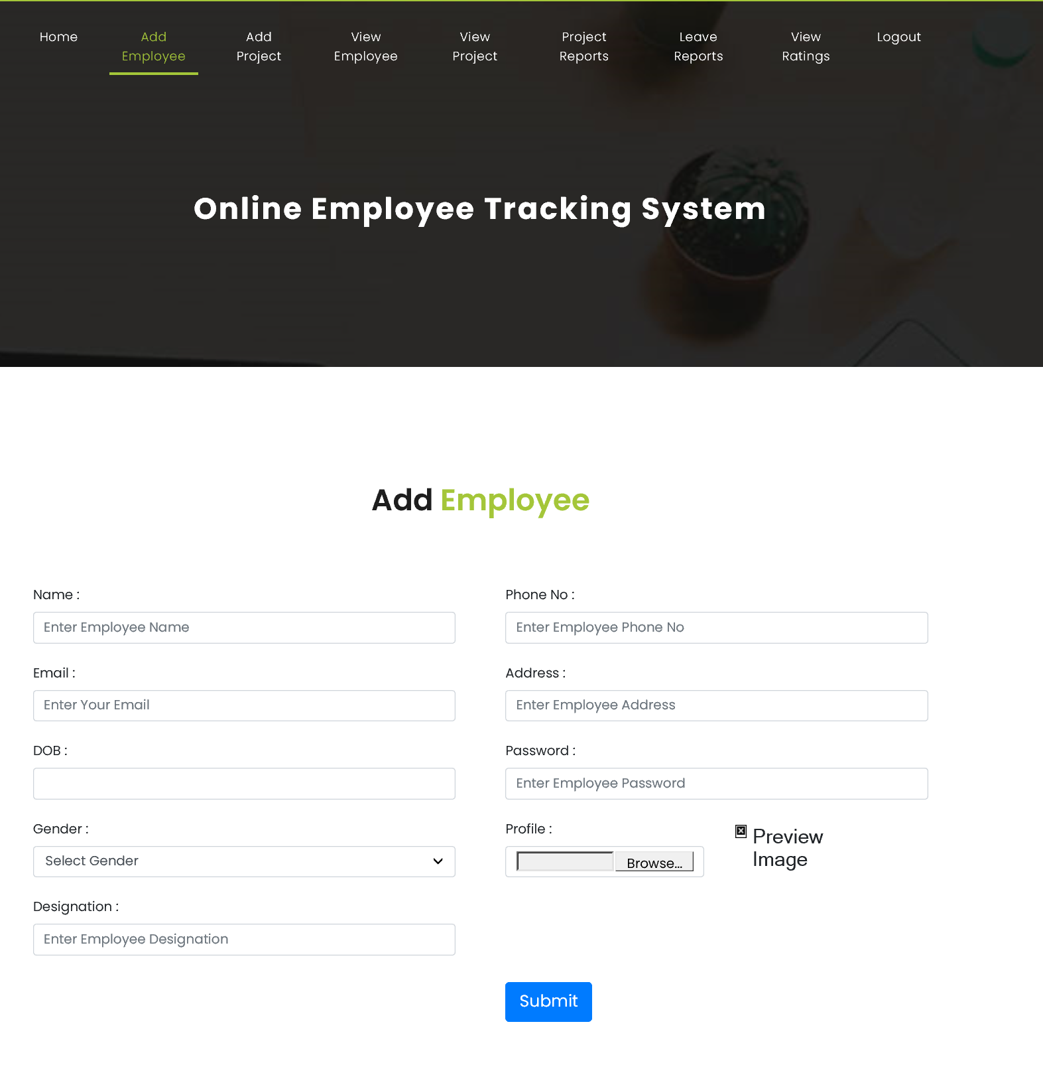
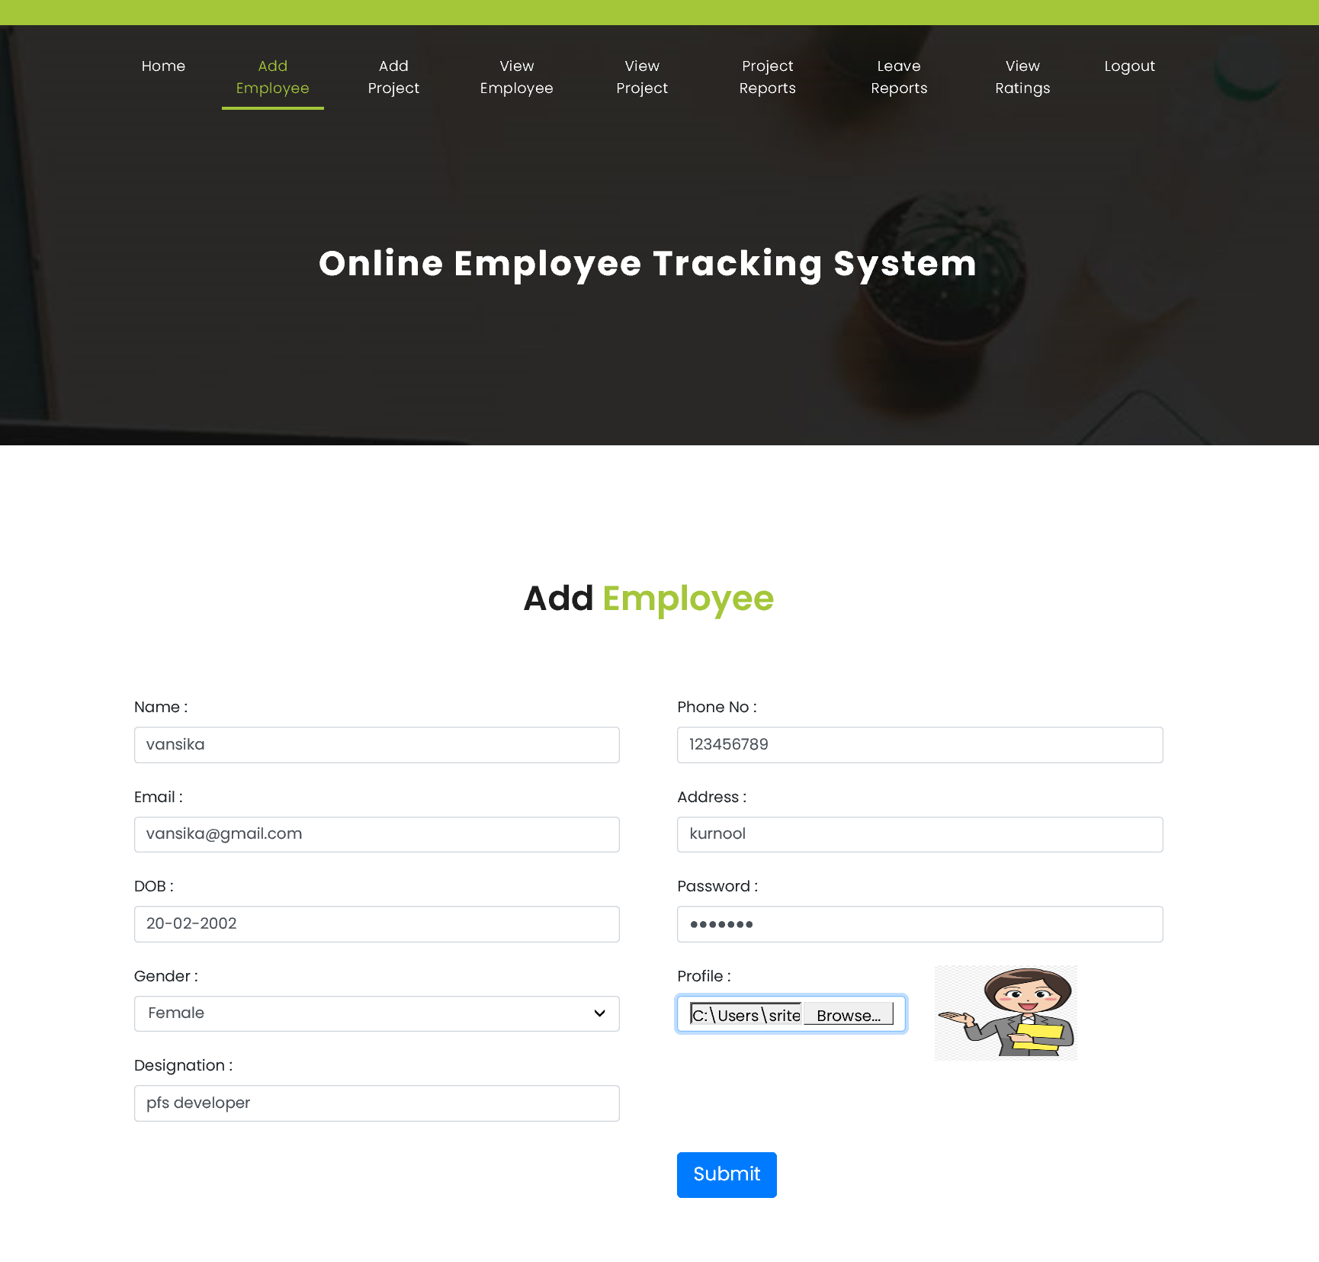
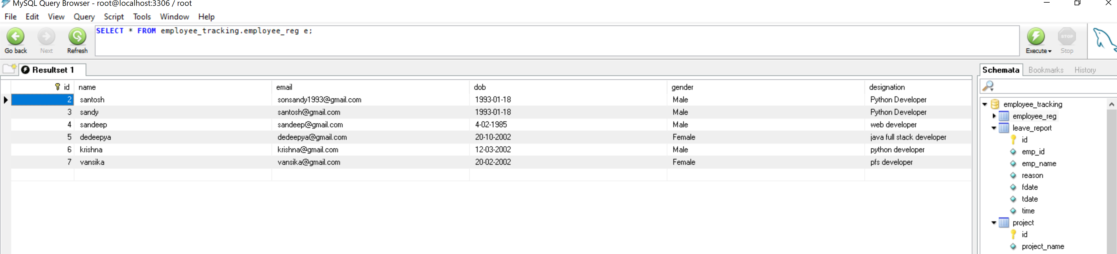

Slide 12
